Slide 1
DS 201
COVID-19 vs. Latitude and Longitude
Final Project Pt 1
By: Ahmed Hassan, Fadel Alshammasi, Mohamed Almansoori

Slide 2
Stage 1: Ask a question
What is the dataset?
The dataset was collected by Johns Hopkins University Center for Systems Science and Engineering. The data itself shows the total number of confirmed, recovered and deaths caused by COVID-19, based on a different areas within a country by way of Longitude and Latitude.
What questions/answer you expect to find?
Does Latitude and Longitude have direct effects on the livelihood of the COVID-19 virus? Does where someone lives based on their Latitude & Longitude pose a threat to the their health and chances of getting the virus?
What are the benefits of this project?
If we can observe that there is a High correlation between Longitude & Latitude and likelihood of getting COVID-19, Medical Industries can optimize where certain services are allocated efficiently.

Slide 3
Stage 2: Get the data
https://datahub.io/core/covid-19#resource-time-series-19-covid-combined
We are getting our data from a DataHub excel spreadsheet that was created on March 22, 2020. (We got it already made from the web).
We cleaned our data by going through it and checking if there were any values that didn’t make sense(e.g., cruise ships, ..etc). We needed to change some inaccurate country names because it was causing problems with our convert to continent function.
We also made sure that there were no duplicates or missing values. There were already no duplicates but we found missing values in the Province/State column AND for the “Recovered” column. For the former, we filled in the missing value by “Not Applicable” since some countries don’t have a province/state. For the later, I interpolated the missing values we ended up giving all of them a value of 0.
We prepared the data by adding another column called “continent” to examine useful information (e.g., in what continent the virus is spreading the most?, latitude longitude in these continents and if there’s a correlation between that and confirmed cases,...etc).
For now, we did not need to acquire more related dataset.

Slide 4
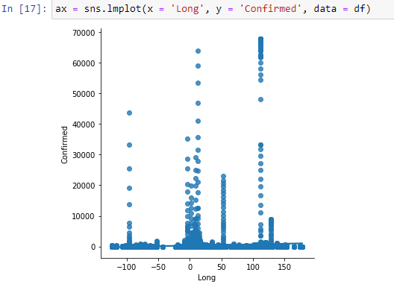
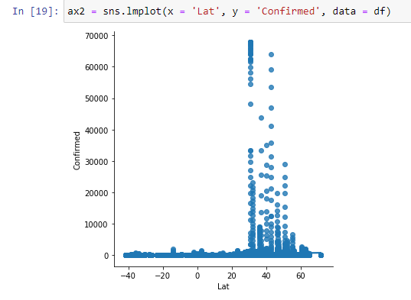
Stage 3: Explore the data
Is there any correlation in COVID-19 spread between Longitude and Latitude regions ?

Slide 5
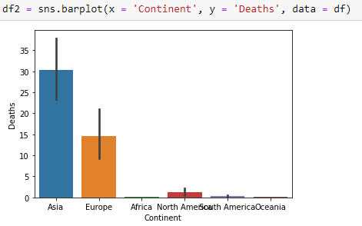
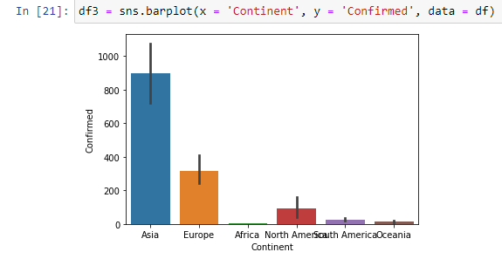
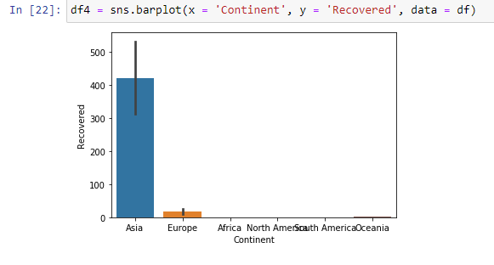

Slide 6
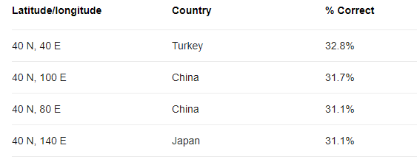
Stage 3: Hypothesis
We can observe, based on the longitude and latitude spread of COVID-19, that regions that are located in the range of 50 - 100 longitude and 30 - 60 latitude have the highest infection rate of the disease.
Based on continents, Asia and Europe have the highest confirmed and death cases.

Slide 7
Stage 3: Problems with data?
Not all country names were actually correct. Some were misspelled, some were not even countries.
The data may become old later since this is an ongoing issue (if the trend continues then there will be more confirmed cases in Europe than Asia).
Ways to improve it? We may incorporate more dataset in the future to keep our data up to date to reach a better conclusion to our hypothesis.

Slide 8
Stage 4: Model the Data
We wanted to predict if Latitude and have a positive correlation on number of COVID-19 cases. So, we selected two countries within our data: China and Canada. We compared Provinces/States in those countries vs Confirmed/Death cases and Latitude.
Explain how you select this ML model:
We decided to use the kNN (n=2) Method, since it randomly selects a sample from the data, and compares it to its neighbors, which are going to be the States/Provinces that this sample might relate to.

Slide 9
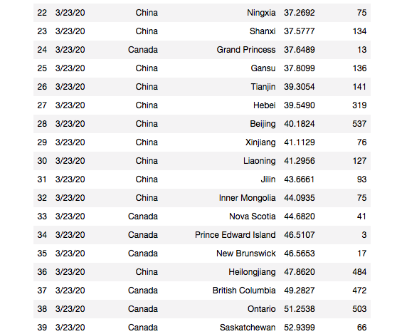
Target vs Features :
Our selected target is:
Province/State (in Canada & China)
Our selected features were the following columns:
Confirmed
Deaths
Lat

Slide 10
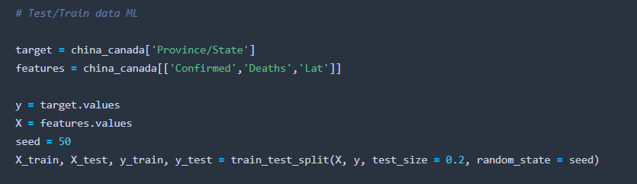
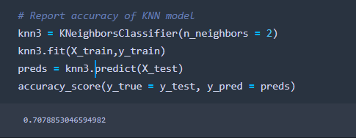
Here we are splitting our main dataset to training and test sets

Slide 11
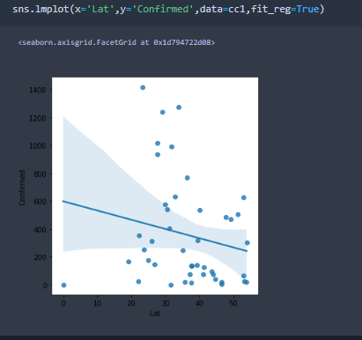
Stage 5: Communicate the Data
Does Latitude and Longitude have direct effects on the livelihood of the COVID-19 virus? Does where someone lives based on their latitude & longitude pose a threat to the their health and chances of getting the virus?
We decided to not conduct the research on longitude, because based on the the Professor's recommendation, longitude is not an area of interest because there’s no relationship between population density and longitude (as with the case with latitude).

Slide 12
Perspective analysis
1. What action can you make after seeing the result of this project?
We could obtain more up-to-date data, as well as use data that included more features to test more hypotheses.
2. What are the potential applications for this project?
Our project can be used by various institutions such as governments or hospitals to track or observe the spread of COVID-19.
3. What could benefit the direct benefit to an organization?
Medical organizations can now ignore lat when observing the spread of COVID-19 due to the fact that our results show a weak negative correlation between Lat and spread of the disease.

